Slide 1
Force and strain measurement

Slide 2
Force and strain measurement methods
Resistance strain gauges
Metal foil gauges
Semiconductor gauges
Thin films
Load cells
Strain gauge based
Piezoelectric based
LVDTs, Extensometers for displacement and/or strain measurement
Capacitive gauges
Moirè strain measurement
Digital Image Correlation
Interferometry

Slide 3
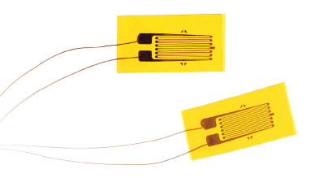
Strain gage principles

Slide 4
Take the total differential of the resistance and normalize by the resistance.

Slide 5
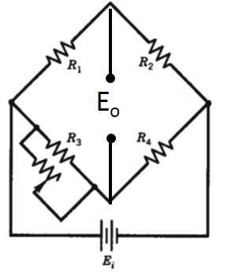
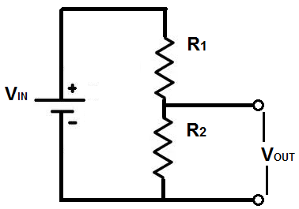
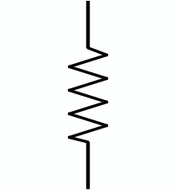
Using Wheatstone bridge to measure resistance changes
R₁
R₃
E_{i}
E_{o}
R₂
R₄

Slide 6
Quarter bridge

Slide 7
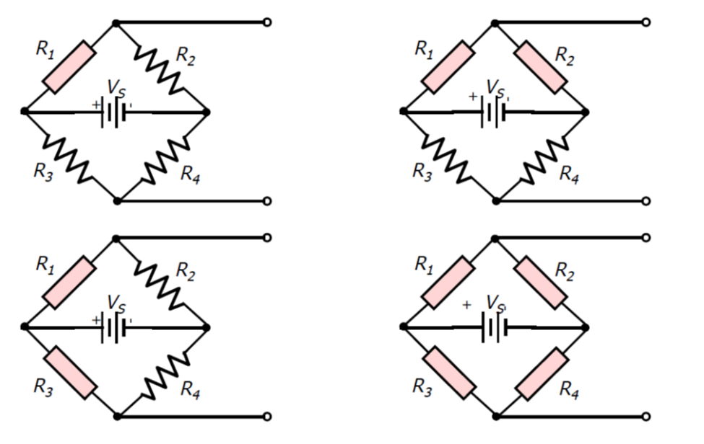
Half bridge

Slide 8
Half bridge v.2

Slide 9
¾ Bridge
No such thing!

Slide 10
Full bridge

Slide 11
Using half and full bridges to increase signal and to cancel out thermal strains
F

Slide 12
Using half to increase signal and to cancel out bending strains

Slide 14
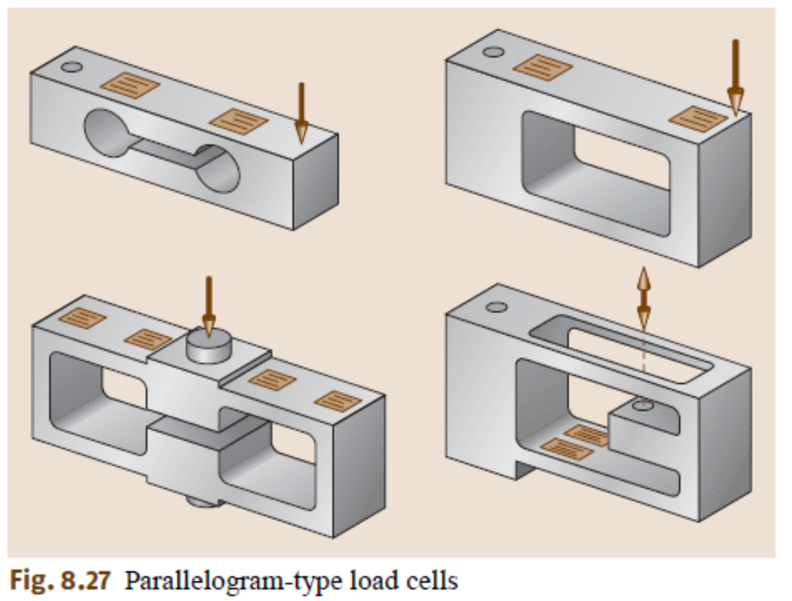
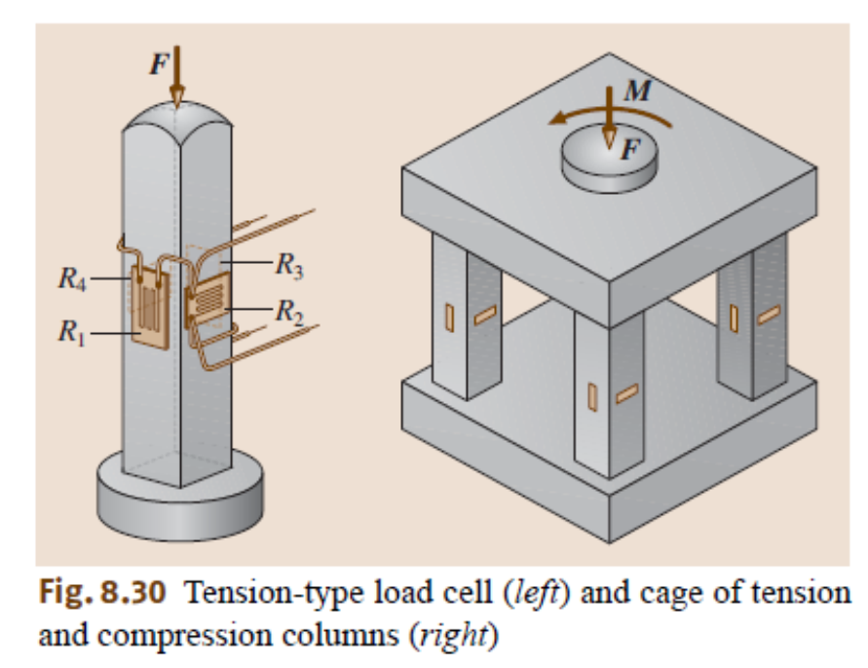
Load cells use full bridges to remove lead wire and thermal strain issues

Slide 15
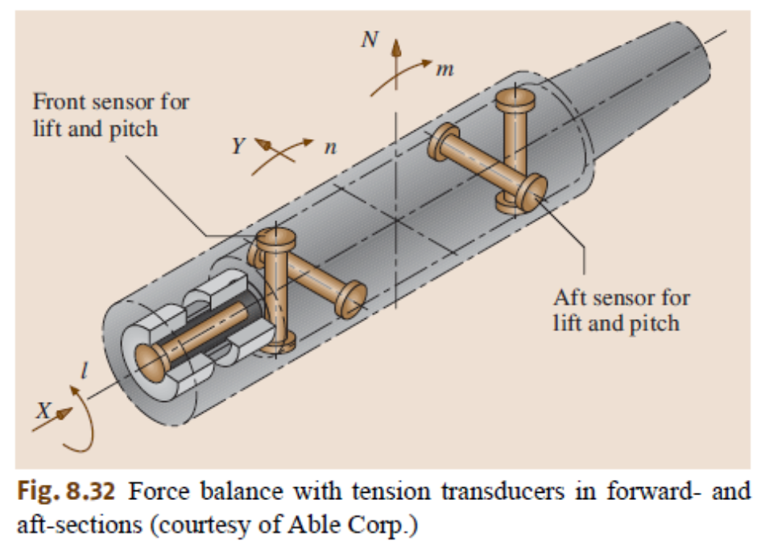
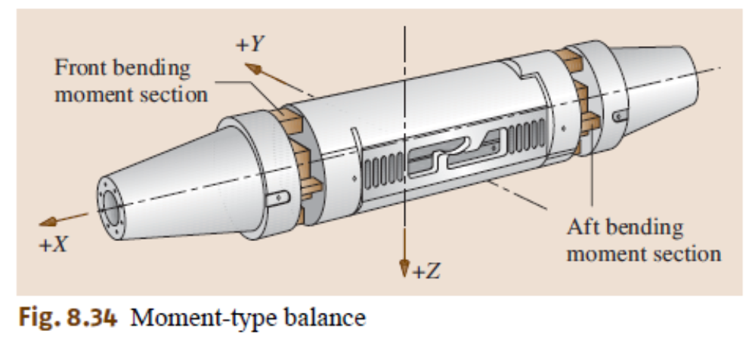

Slide 16
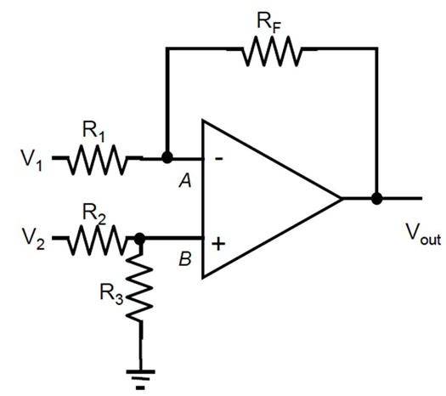
Reading load cell output
Load cells are usually described in terms of output for full scale load. For instance, if the calibration sheet for a FS = 5000 N full scale load cell states the sensitivity is S_{LC} = 3.2 mV/V, this means that the output of the bridge will be 3.2 mV for a volt of excitation (E_{ex}).
The output of the bridge is always amplified with a differential amplifier because the signal is small and because the voltage is measured between two points neither of which is ground.
The output voltage for a given force is:
The force for a measured voltage is:
Differential amplifier having a gain, G = R_{F}/R₁.
(R₁, R₂, and R₃ are not the bridge resistors).

Slide 17
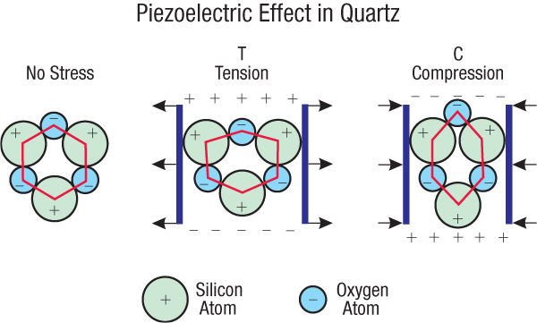
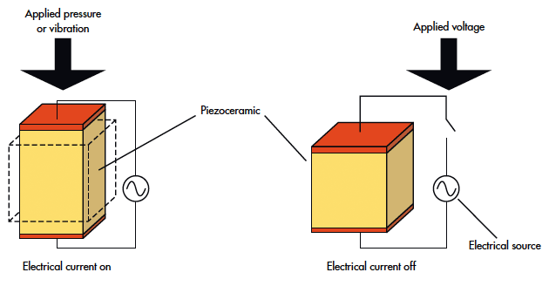
Piezoelectric effect – crystal deformation displaces the relative center of charge resulting in the development of charge across the faces.

Slide 18
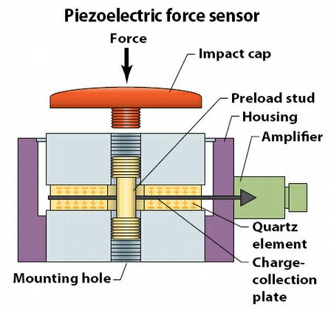

Slide 19
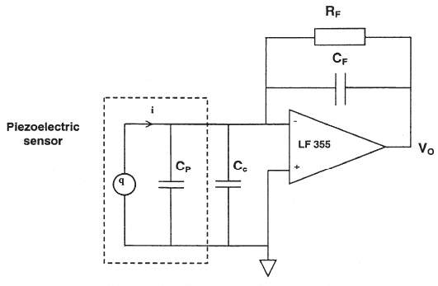
Charge amplifier used to convert charge to voltage by integrating the current over a specified time. It will not detect a static force.

Slide 20
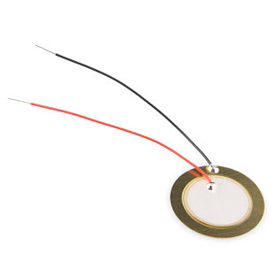
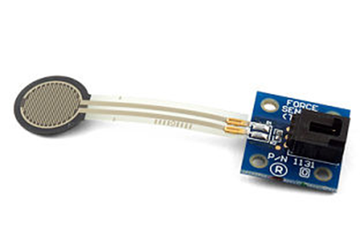
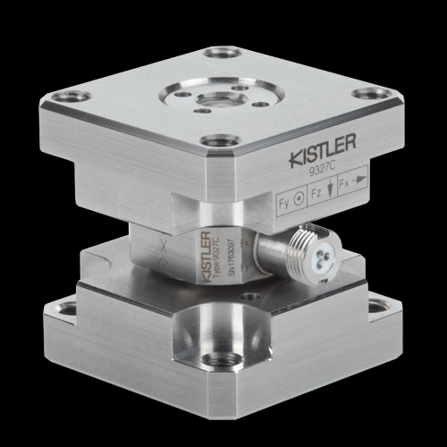
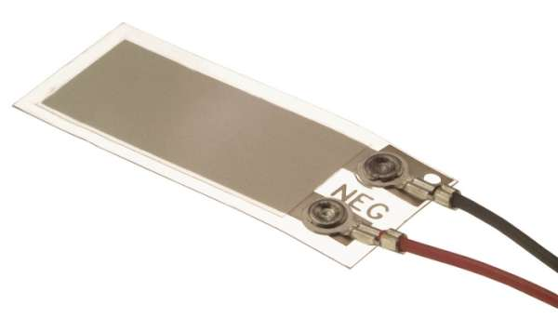
Typical maximum frequency for a strain gauge load cell is 2-8kHz Hz. Piezoelectric load cells range from 0.3 to 100,000 Hz.
Full scale deflection on the order of 0.1 mm for strain gauge load cells. PZT load cells are typically an order of magnitude stiffer.

Slide 22
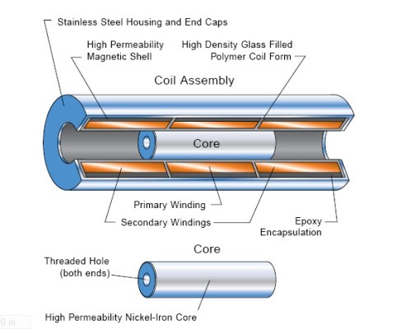
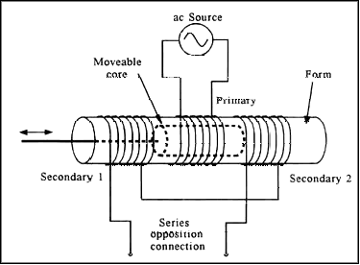
LVDT – linear variable differential transformer Measures displacements with high displacement resolution.

Slide 23
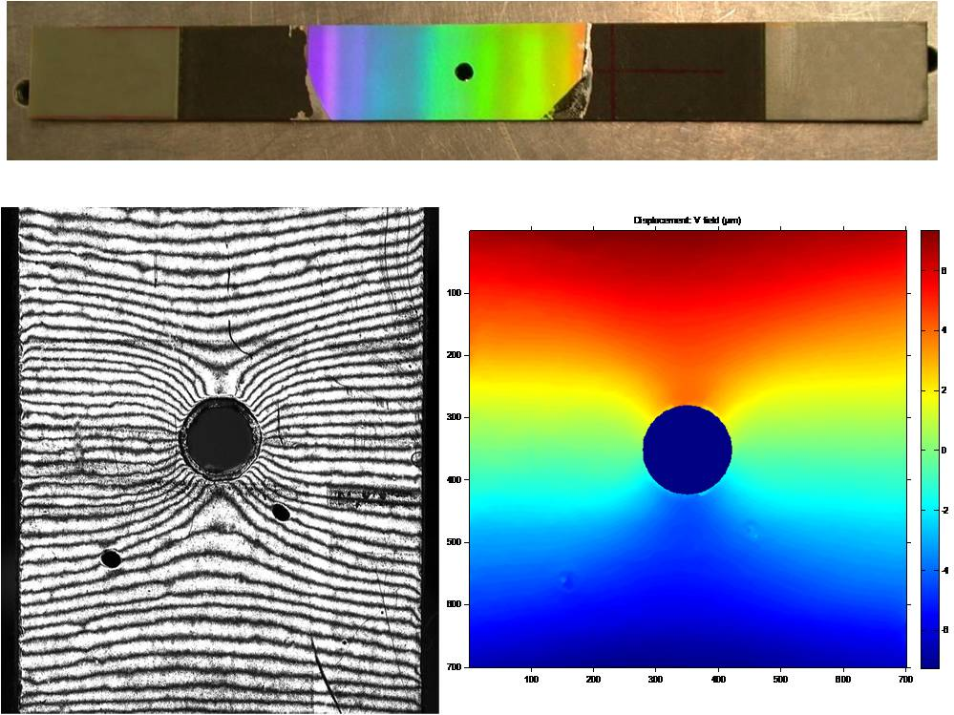
Moire methods

Slide 25
θ= 6 degrees + 2.5% strain
θ = 6 degrees

Slide 26
-10 degree rotation
p’=0.47 in
p=0.4 in

Slide 27
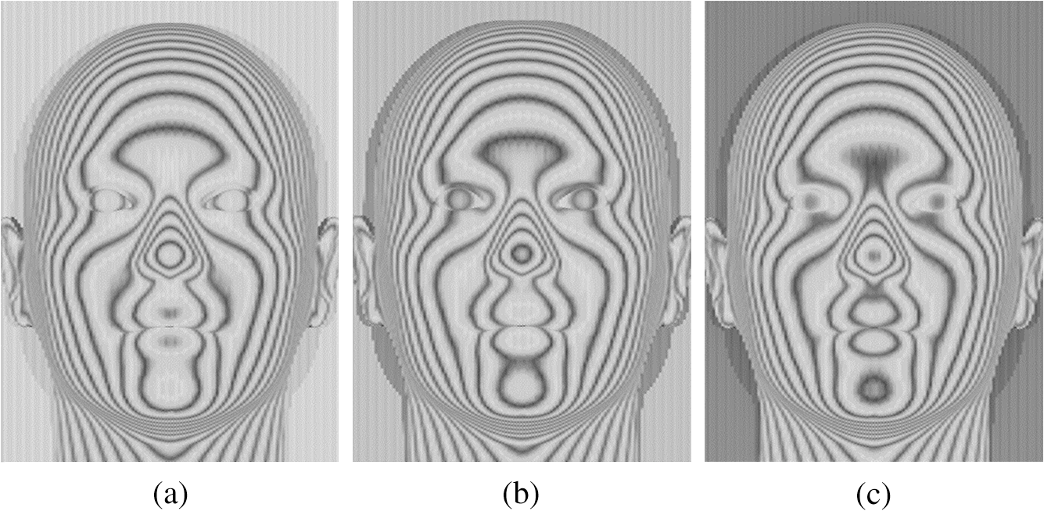
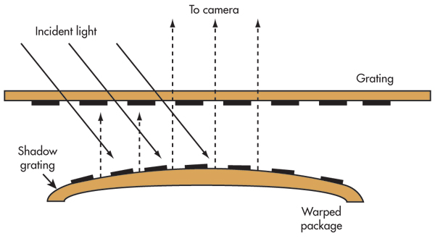
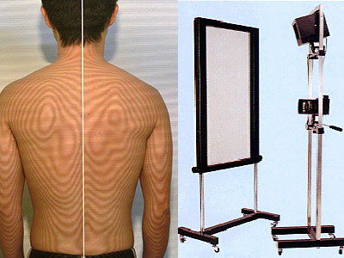
Out of plane displacement measurement

Slide 28
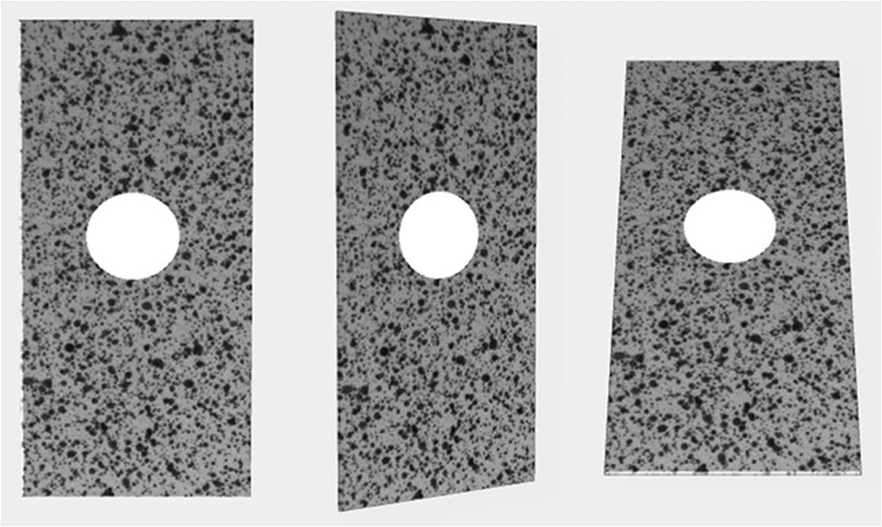
Digital image correlation

Slide 29
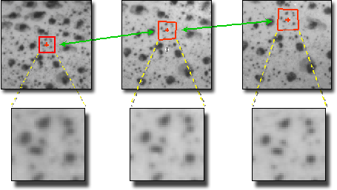
Example from Correlated Solutions web site

Slide 30
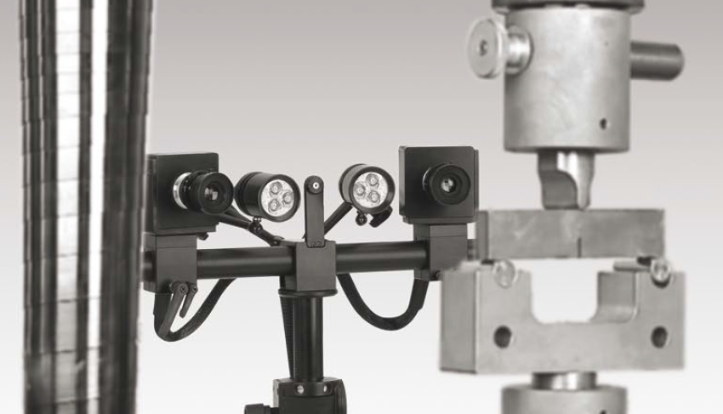
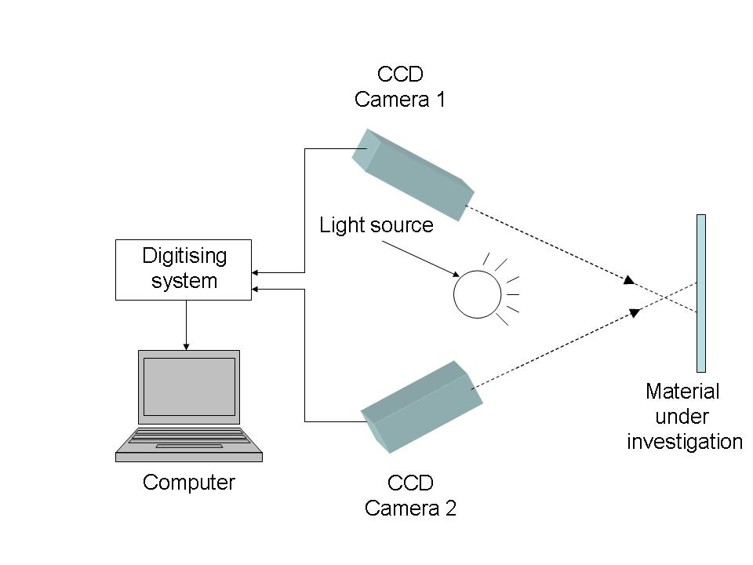
LIMESS web site has a few videos http://www.limess.com/index.php/en/company/technology/digital-image-correlation http://www.limess.com/index.php/en/applications/deformation-strain-measurement
Left image from http://trilion.com/when-is-a-digital-image-correlation-system-the-right-tool/
Right image from http://lib.znate.ru/docs/index-99125.html

Slide 31
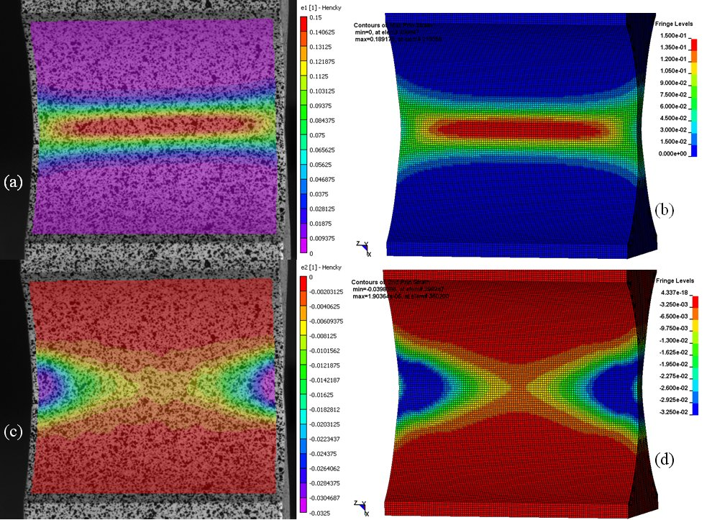

Slide 33
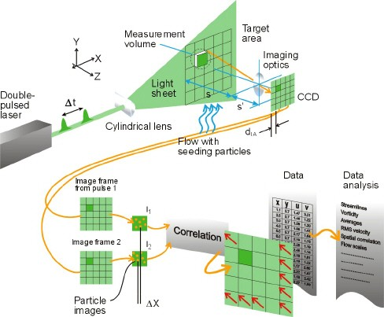
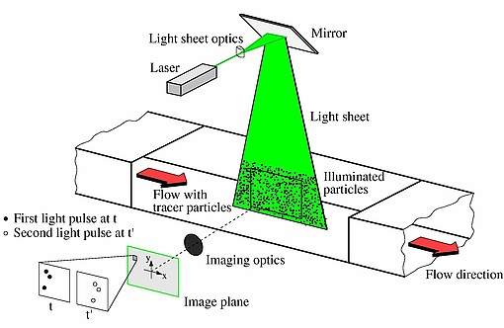
Particle imaging velocimetry

Slide 34
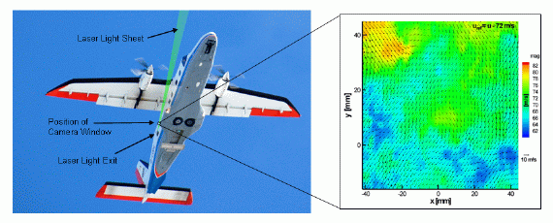
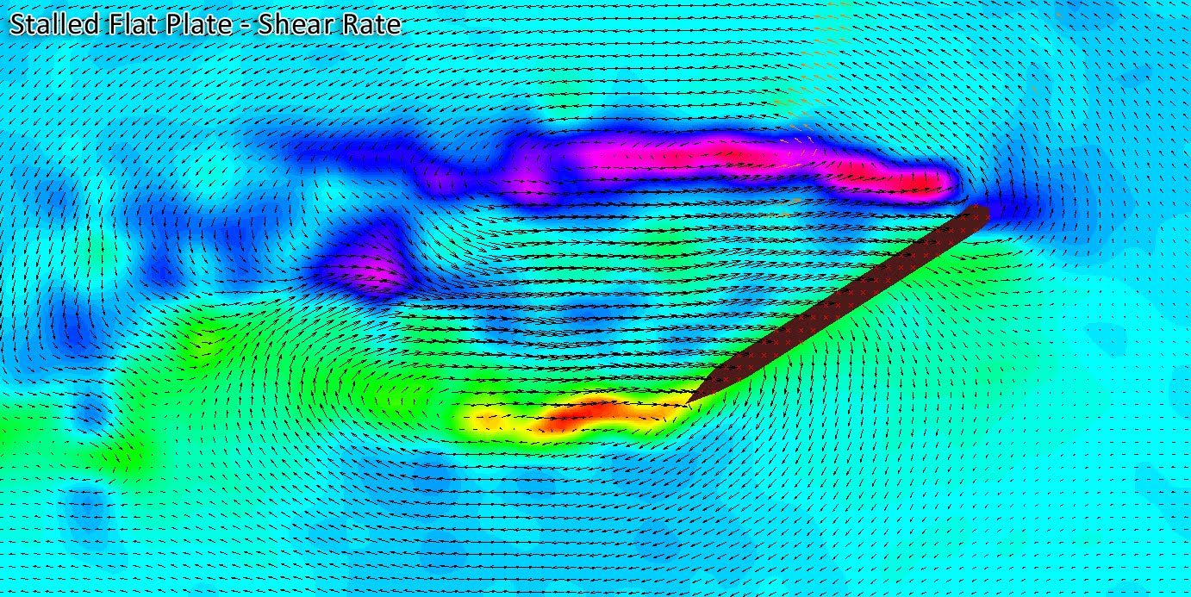

Slide 35
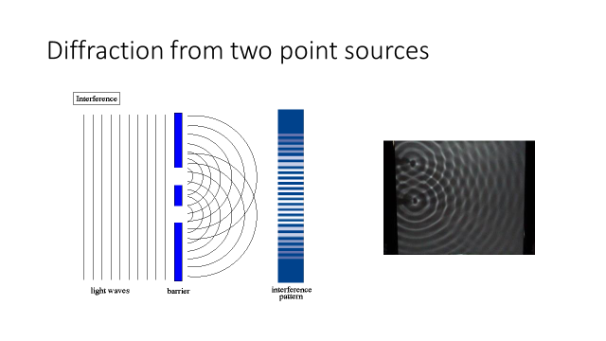
Electronic speckle pattern interferometry

Slide 36
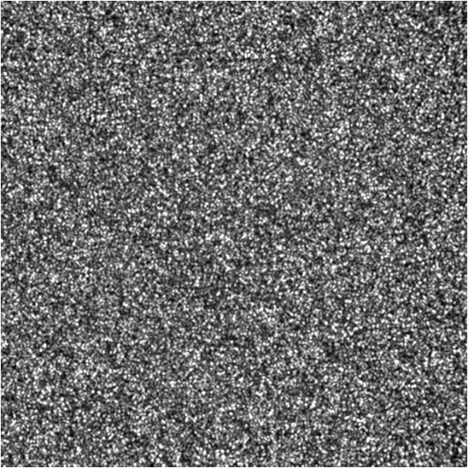
Laser speckle – arises from random interference between all scattering points on surface
Assume the phase at every point is independent of the other points. This suggests the average U will follow Gaussian statistics. The irradiance probability is described by where the most likely probability is an intensity of zero. This changes when two beams are added together

Slide 37
Out-of-plane displacement measurement using speckle interferometry

Slide 39
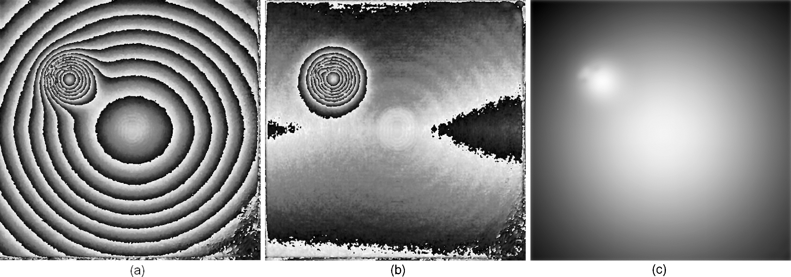

Slide 40
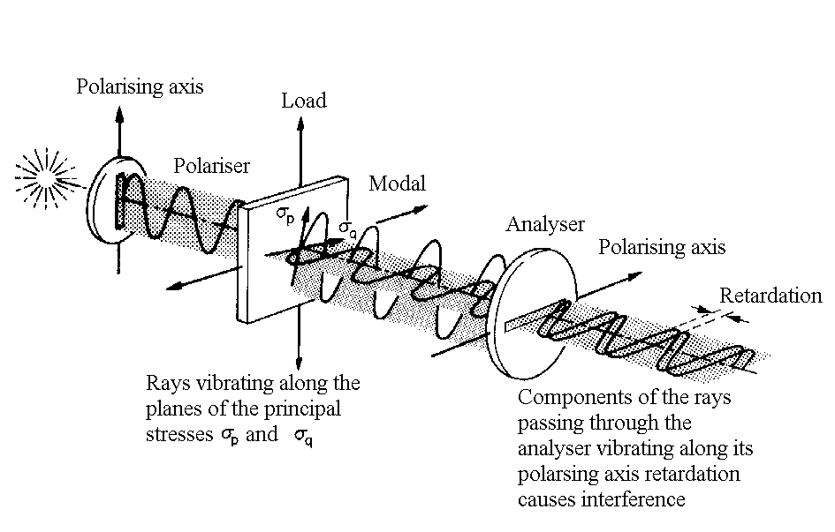
Photoelasticity
Stress-optic law

Slide 41
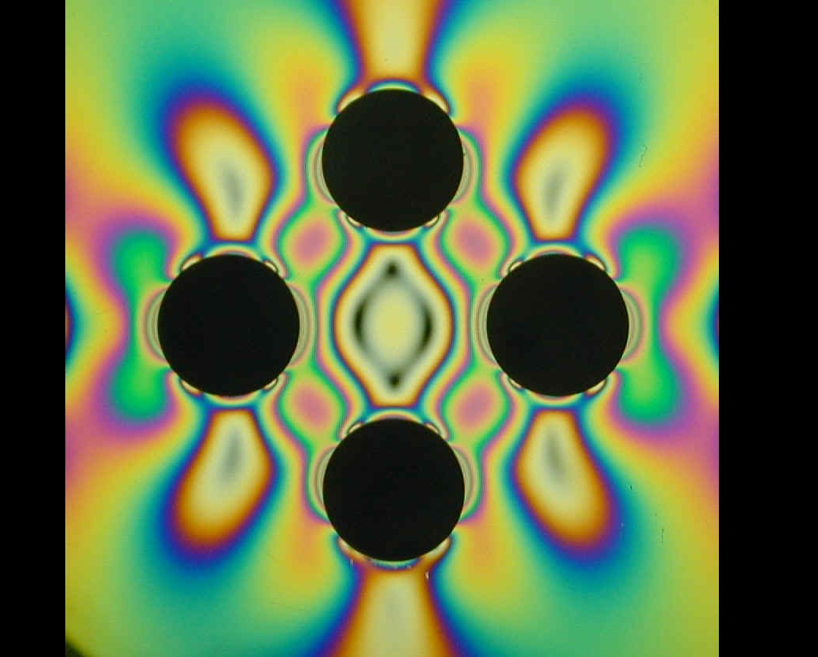
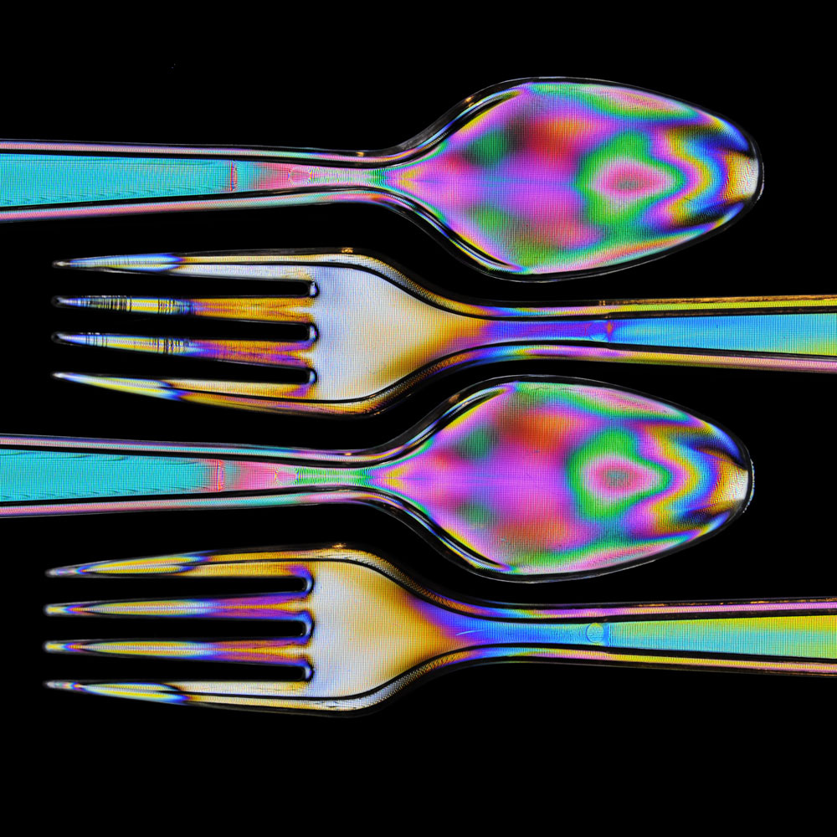

Slide 42
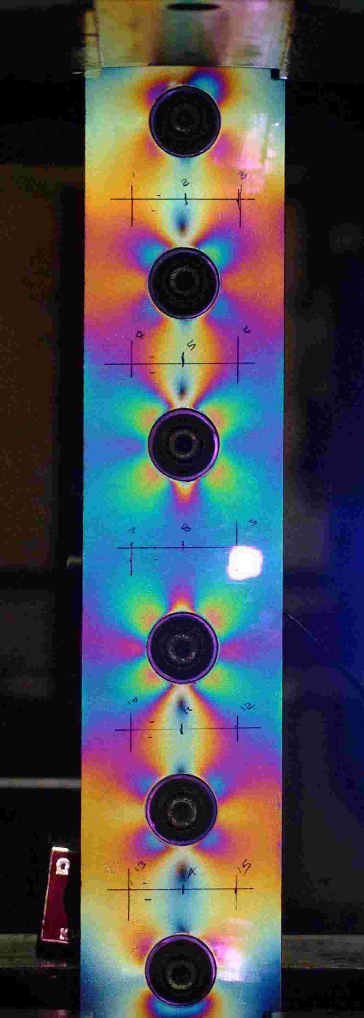
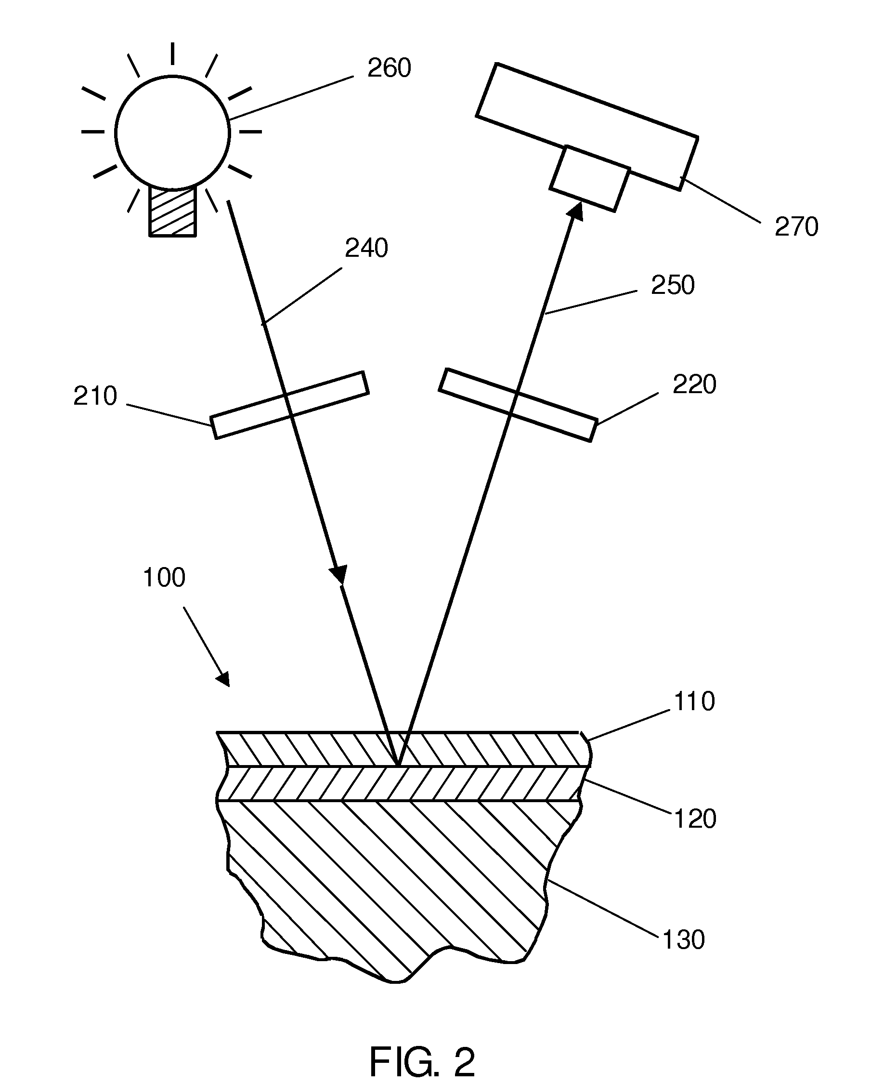
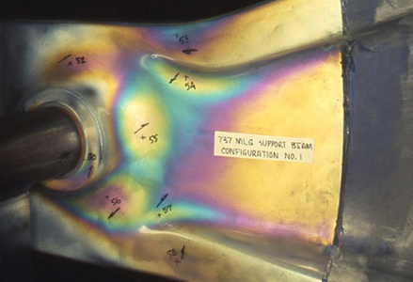
Photoelastic coatings

